Slide 1
Platforms: Lecture 2: When 1 + 1 = 10

Slide 2
Denary
The numbers in normal use are called denary (or base 10).
The denary number system uses 10 digits: 0,1,2,3,4,5,6,7,8,9.
(When a number contains more than one digit) each digit is worth ten times a similar digit to its immediate right.
i.e.
100 10 1 ‘column’ headings
2 5 7 digits
Thus the number 257 would represent (2 x 100) + (5 x 10) + (7 x 1)

Slide 3
Binary
The binary number system uses just two digits: 0 and 1.
A binary digit is normally referred to as a bit and each bit is worth two times the digit to its immediate right.
To translate a binary number into denary we can place the bits in columns that are labelled with their values.
128 64 32 16 8 4 2 1 ‘column’ headings denary values
0 1 0 0 1 1 1 0 digits
Thus the binary number 01001110 would represent (0 x 128) + (1 x 64) + (0 x 32) + (0 x 16) + (1 x 8 ) + (1 x 4) + (1 x 2) + (0 x 1) = 64₁₀ + 8₁₀ + 4₁₀ + 2₁₀ = 78₁₀

Slide 4
Translating denary to binary 1
To translate a denary number to binary you should do the following:
Write down the binary column headings , starting with the right hand column. You continue to add columns until you get to the column that has a value greater than the denary number.
You place a 0 in this column.
You now process each column from left to right.
If the denary number to be translated is greater or equal to the column heading, place a 1 in the column and subtract the value of the column from the denary value.
If the denary value is smaller than the column heading you simply place a zero in the column.

Slide 5
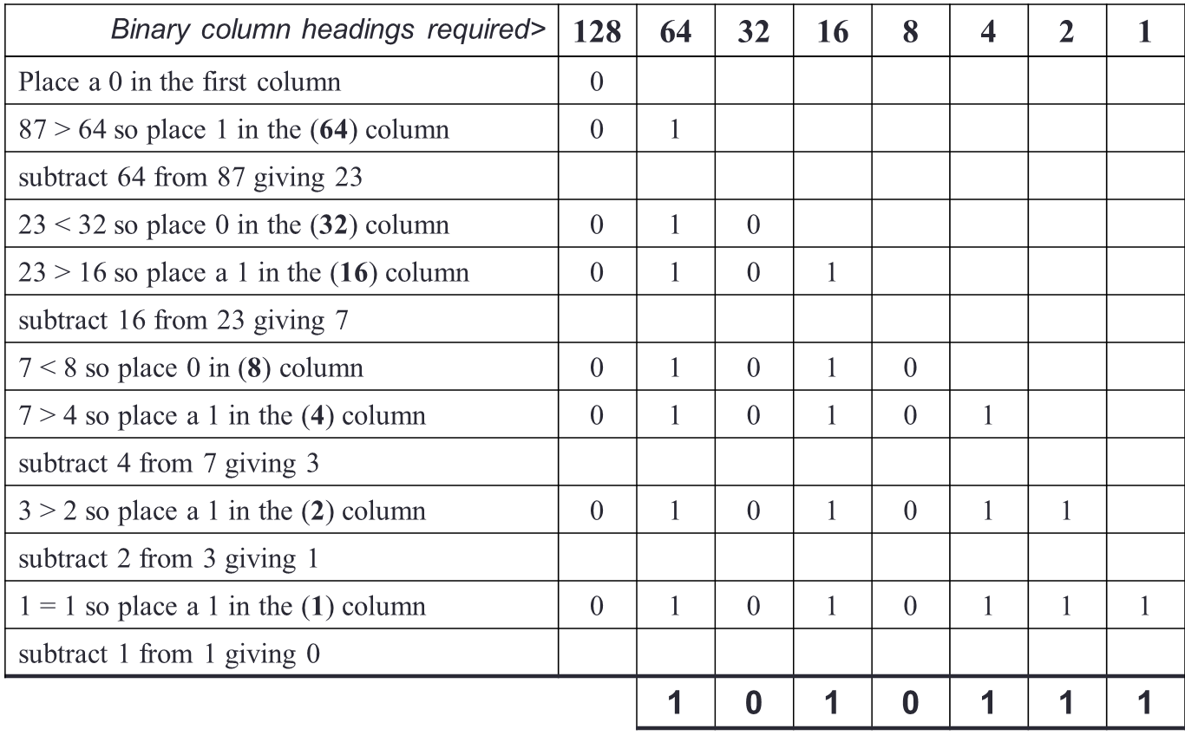
Translating denary to binary 2 (example 87₁₀ to binary)

Slide 6
Hexadecimal 1
The hexadecimal number system uses 16 digits: 0,1,2,3,4,5,6,7,8,9,A,B,C,D,E,F
Each digit is worth 16 times a similar digit to its immediate right.
To translate a hexadecimal number into denary we can place the digits in columns that are labelled with their values. Example hexadecimal number: 1C5

Slide 7
Hexadecimal 2
Example: hexadecimal number 1C5
256 16 1 ‘column’ headings denary values
1 C 5 digits
As C represents twelve the hexadecimal number 1C5 would represent
(1 x 256₁₀) + (12 x 16₁₀) + (5 x 1₁₀)
= 256₁₀ + 192₁₀ + 5₁₀ = 453₁₀

Slide 8
Translating binary to hexadecimal
Divide the binary number into groups of four digits (starting from the rightmost digit). You now convert each group of four digits into a single hexadecimal digit
Example: In order to convert 0110111110010111
divide the number into groups of four, giving 0110 | 1111 | 1001 | 0111
the hexadecimal equivalent is 6 F 9 7

Slide 9
Translating denary to hexadecimal
Write down the hexadecimal column headings, starting with the right hand column. You continue to add columns until you get to the column that has a value greater than the denary number.
You place a 0 in this column
You now process each column from left to right
Divide the denary number by the column heading. The result is placed in the column and the remainder becomes the denary number still to be translated.

Slide 10
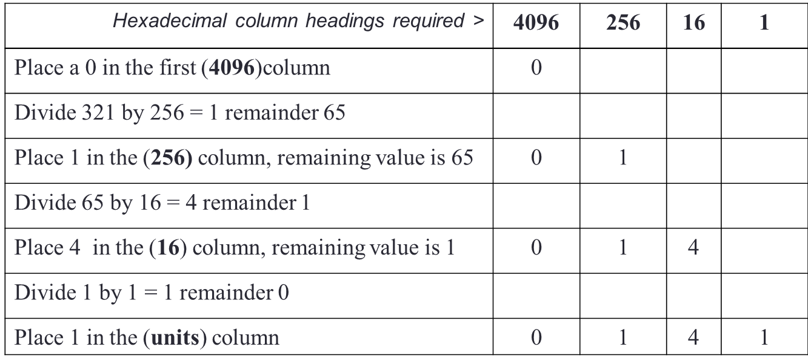
Translating denary to hexadecimal
Example: Convert 321₁₀ to hex
So 321₁₀ is 141₁₆

Slide 11
Octal 1
The octal number system uses 8 digits:
0,1,2,3,4,5,6,7
Each digit is worth 8 times a similar digit to its immediate right.
To translate an octal number into denary we can place the digits in columns that are labelled with their values. Example octal number: 325₈

Slide 12
Octal 2
Example: octal number 325₈
64 8 1 ‘column’ headings denary values
3 2 5 digits
The octal number 325 would represent
(3 x 64₁₀) + (2 x 8₁₀) + (5 x 1₁₀)
= 192₁₀ + 16₁₀ + 5₁₀ = 213₁₀

Slide 13
Translating binary to octal
Divide the binary number into groups of three digits (starting from the rightmost digit). You now convert each group of three digits into a single octal digit
Example: In order to convert 0110111110010111
divide the number into groups of three, giving 0 | 110 | 111 | 110 | 010 | 111
the octal equivalent is 0 6 7 6 2 7

Slide 14
Translating denary to octal
Write down the octal column headings, starting with the right hand column. You continue to add columns until you get to the column that has a value greater than the denary number.
You place a 0 in this column
You now process each column from left to right
Divide the denary number by the column heading. The result is placed in the column and the remainder becomes the denary number still to be translated.

Slide 15
Translating denary to octal
Example: Convert 435₁₀ to octal
So 435₁₀ is 663₈
Octal column headings required > | 512 | 64 | 8 | 1
Place a 0 in the first (512) column | 0
Divide 435 by 64 = 6 remainder 51
Place 6 in the (64) column, remaining value is 51 | 0 | 6
Divide 51 by 8 = 6 remainder 3
Place 6 in the (8) column, remaining value is 3 | 0 | 6 | 6
Divide 3 by 1 = 3 remainder 0
Place 3 in the (units) column | 0 | 6 | 6 | 3

Slide 16
Translating octal to hexadecimal and vice versa
Translate octal to binary and the resulting binary to hexadecimal
Translate hexadecimal to binary and the resulting binary to octal

Slide 17
Binary Arithmetic
Rules of Binary Addition
0 + 0 = 0
0 + 1 = 1
1 + 0 = 1
1 + 1 = 0, and carry 1 to the next more significant bit
This is equivalent (bar the carrying) to the Exclusive-OR (XOR) operation
Addition Example:
1 0 1 0 1 1 0 1
1 0₁ 0₁ 1₁ 0₁ 1 0₁ 1
(1) 0 1 0 0 0 0 1 0

Slide 18
Binary Arithmetic
Rules of Binary Subtraction
0 - 0 = 0
0 - 1 = 1, and borrow 1 from the next more significant bit
1 - 0 = 1
1 - 1 = 0
Subtraction example: 00100101 - 00010001 = 00010100
0 0 1 ¹0 0 1 0 1
- 0 0 0 1 0 0 0 1
0 0 0 1 0 1 0 0

Slide 19
Binary Arithmetic
Rules of Binary Multiplication
0 x 0 = 0
0 x 1 = 0
1 x 0 = 0
1 x 1 = 1, and no carry or borrow bits
aka ANDing (the rules are the same as that for the AND operation)
Bitwise logical AND operation compares 2 bits and if they are both "1", then the result is "1", otherwise, the result is "0".
Used in network address calculations/ subnetting

Slide 20
Binary Arithmetic
Multiplication example: 00101001 × 00000110 = 11110110
0 0 1 0 1 0 0 1
× 0 0 0 0 0 1 1 0
0 0 0 0 0 0 0 0
0 0 1 0 1 0 0 1
0 0 1 0 1 0 0 1
0 0 1 1 1 1 0 1 1 0

Slide 21
Binary Arithmetic
Bitwise logical AND between 11111010 and 00110111
Remember the rules: compare each pair of bits; only get ‘1’ result if both are ‘1’
1 1 1 0 1 0 0 1
0 0 1 1 0 1 1 1
0 0 1 0 0 0 0 1

Slide 22
Binary arithmetic
Binary division is the repeated process of subtraction, just as in decimal division.
Division example: 00101010 ÷ 00000110 = 00000111
1 1 1
110) 0 0 1 0 1 0 1 0
- 1 1 0
1 0 0 1
- 1 1 0
1 1 0
- 1 1 0
0

Slide 23
Binary arithmetic
The reality of binary arithmetic is that it is usually faster and more accurate for us humans to convert the binary values to denary, do the calculation, and convert the result back!

Slide 24
Binary Logic Tables
NOT Logic Table
Input A | Output
0 | 1
1 | 0
OR Logic Table
Input A | Input B | Output
0 | 0 | 0
0 | 1 | 1
1 | 0 | 1
1 | 1 | 1
AND Logic Table
Input A | Input B | Output
0 | 0 | 0
0 | 1 | 0
1 | 0 | 0
1 | 1 | 1
XOR Logic Table
Input A | Input B | Output
0 | 0 | 0
0 | 1 | 1
1 | 0 | 1
1 | 1 | 0
NAND Logic Table
Input A | Input B | Output
0 | 0 | 1
0 | 1 | 1
1 | 0 | 1
1 | 1 | 0
NOR Logic Table
Input A | Input B | Output
0 | 0 | 1
0 | 1 | 0
1 | 0 | 0
1 | 1 | 0

Slide 25
Data representation
Any Data in the computer or stored as digital values is represented by binary numbers (bits).
What binary number corresponds to a specific piece (value) of data depends on the Coding scheme used.
Actual numbers ( 34, -9, 4.5) can be represented in different ways
Begin with the integers as examples

Slide 26
Unsigned Integer
An unsigned integer is stored as a pure binary number.
It only allows the storage of positive integers.
If we consider an unsigned integer which is stored as 8 bits (i.e. one byte),
the smallest value that can be stored is 00000000 which represents 0₁₀
the largest value that can be stored is 11111111 which represents 255₁₀
Larger numbers are stored as multiples of 1 byte, i.e. as words of 16 bits, 32 bits or 64 bits, & often handled in byte size chunks (i.e. Upper Byte, Lower Byte)

Slide 27
Signed Integers 1
Sign and Magnitude
When the sign and magnitude format is used the leftmost digit is not part of the value but is used to represent the sign of the number.
If the left most digit is a 0 the sign is + If the leftmost digit is 1 the sign is -
E.g. (in 8 bits)
+5 = 00000101
- 5 = 10000101

Slide 28
Signed Integers 2
Sign and Magnitude
Range of values when using 8 bits:
Note the oddity of two values for 0!
01111111 | ≡ | + 127
:
00101101 | ≡ | +45
:
00001000 | ≡ | +8
:
00000001 | ≡ | +1
00000000 10000000 | ≡ ≡ | +0 -0
10000001 | ≡ | -1
:
10001000 | ≡ | -8
:
10101101 | ≡ | -45
:
11111111 | ≡ | -127

Slide 29
Signed Integers 3
Sign & Magnitude Arithmetic example:
00101101 + 45₁₀ +
10101101 - 45₁₀
11011010 ≠ 0₁₀
the binary arithmetic gives the wrong answer 11011010 does NOT equal 0 (which the denary sum clearly shows IS the answer!!)
Hence use of ‘Twos complement’ rather than ‘sign&magnitude’ for storing negative numbers.

Slide 30
Two's Complement 1
A method of storing negative numbers in binary form
Used to ensure that the difficult arithmetic with negative numbers gives the correct answer!
(Note there is also one's complement representation but this still has two zeros, issues with arithmetic borrowing, so does not get much use)

Slide 31
Two's complement 2
Converting a negative denary number into Two’s Complement binary form:
Find the binary value of the denary number, ignoring the – sign.
Add 0s to the left of the value (you will always be asked to store the two's complement representation in a set number of bits).
Change all the 1s to 0s and all the 0s to 1s (we call this “flipping the bits”). [You now have the one's complement value]
Add 1 to the result.

Slide 32
Two's complement 3
Example: To translate –5₁₀ to twos complement format in 8 bits
Translate 5₁₀ to binary = 101
Add 0s to the left making the number 8 bits long 101 → 00000101
Flip the bits 00000101 → 11111010
Add 1 11111010 + 1 = 11111011
so –5₁₀ converts to 11111011 in two’s complement form

Slide 33
Two's complement 4
To translate a two's complement number to denary you must first check the leftmost bit to decide whether it is 0 (+) or 1 (-).
If it is 0 (+) you can simply convert the binary number to denary.
If it is 1 (-) you can discover the positive value by flipping all the bits and adding 1.

Slide 34
Two's complement 5
Example: Translate 11111011_{two’s complement} to denary
Note it is a negative number,
Flip all the bits 11111011 → 00000100
Add 1 00000100 + 1 = 00000101 = 5₁₀
So 1111101_{two’s complement} = - 5₁₀

Slide 35
Two's complement 6
Range of values when using 8 bits:
01111111 | ≡ | +127
:
00101101 | ≡ | +45
:
00001000 | ≡ | +8
:
00000001 | ≡ | +1
00000000 | ≡ | 0
11111111 | ≡ | -1
:
11111000 | ≡ | -8
:
11010011 | ≡ | -45
:
10000001 | ≡ | -127

Slide 36
Two's complement 7
Two’s Complement Arithmetic example:
00101101 +45₁₀ +
11010011 - 45₁₀
(1) 00000000 = 0₁₀
Use two’s complement for negative numbers and binary arithmetic gives the correct answer

Slide 37
What is floating point?
Up to now, only considered positive and negative integers, but what about real numbers (0.125, -2.5, etc.)?
Floating point is a method for representing real numbers on a computer
There is an IEEE standard, extremely widely adopted, that specifies how to implement floating point numbers in a way that ensures the same answers are generated by different hardware and that these are the correct answers!

Slide 38
Floating Point Definitions
Each floating-point implementation has a base (2, 8, 10, 16) – typically binary
Precision is the number of digits of the base held in a floating-point number
If base is 2 and precision is 24, then 0.1 is stored as 1.10011001100110011001101 x 2⁻⁴ (which is an approximation!)
1.10011001100110011001101 is the significand (or mantissa)
-4 is the exponent
Both significand and exponent are positive and negative

Slide 39
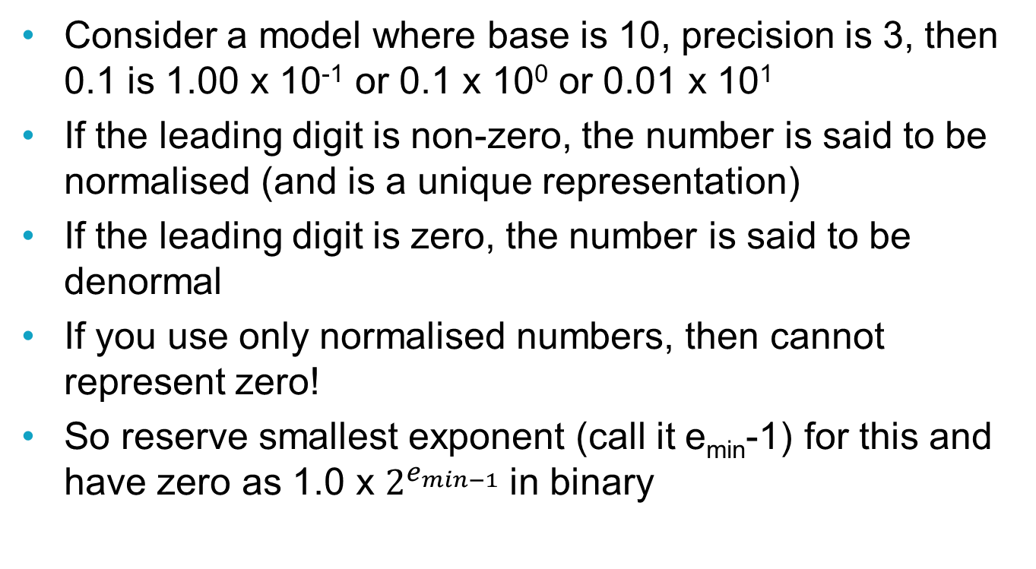
Floating Point Definitions 2
Consider a model where base is 10, precision is 3, then 0.1 is 1.00 x 10⁻¹ or 0.1 x 10⁰ or 0.01 x 10¹
If the leading digit is non-zero, the number is said to be normalised (and is a unique representation)
If the leading digit is zero, the number is said to be denormal
If you use only normalised numbers, then cannot represent zero!
So reserve smallest exponent (call it e_{min}-1) for this and have zero as 1.0 x $2^{e_{min−1}}$ in binary

Slide 40
IEEE Standard
IEEE 754 specifies floating-point representations of varying bit length – underpins implementations in hardware and software
"Single precision" is for 32-bit values, "Double" precision is for 64-bit values
Single precision format is 1 bit for the sign of the significand, 8 bits for the exponent, 23 bits for the significand.
Precision is 24 digits because have a hidden bit due to normalised numbers being used
Zero is exponent of e_{min}-1 and significand of all zeros. Positive and negative zeros!

Slide 41
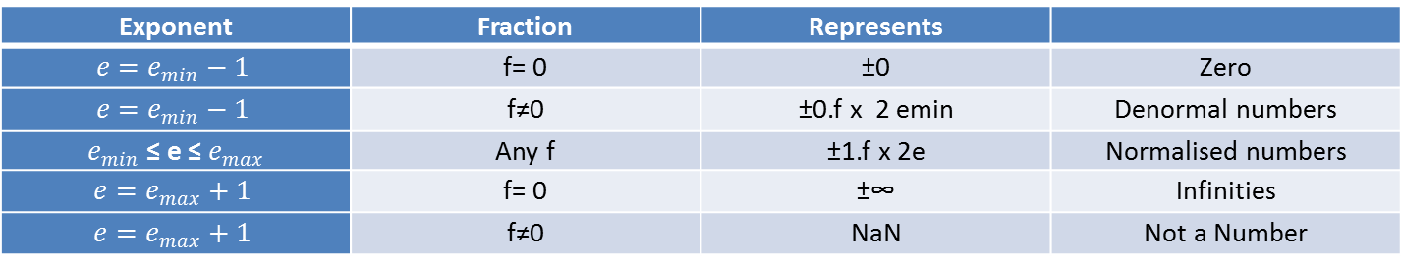
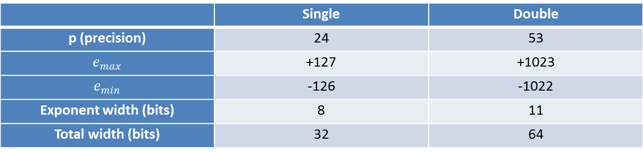
IEEE Standard (part 2)
Exponents are stored using a biased representation where if e is the exponent of a floating-point number, then the bit-pattern of the stored exponent has value e + e_{max} when it is interpreted as an unsigned integer
 | Single | Double
p (precision) | 24 | 53
$$e_{max}$$ | +127 | +1023
$$e_{min}$$ | -126 | -1022
Exponent width (bits) | 8 | 11
Total width (bits) | 32 | 64
Exponent | Fraction | Represents
$$e=e_{min}−1$$ | f= 0 | ±0 | Zero
$$e=e_{min}−1$$ | f≠0 | ±0.f x 2 emin | Denormal numbers
$e_{min}$ ≤ e ≤ $e_{max}$ | Any f | ±1.f x 2e | Normalised numbers
$$e=e_{max}+1$$ | f= 0 | ±∞ | Infinities
$$e=e_{max}+1$$ | f≠0 | NaN | Not a Number

Slide 42
Some Floating Point Issues
Floating point is a finite arithmetic (same number of bits for integers and floating-point numbers so same number of representable numbers)
In mathematical terms, the numbers do not represent a field ( add two really big numbers, the sum might "overflow" and not be representable, divide two numbers and the result might "underflow").
Some numbers cannot be represented precisely, 0.1 and 0.01

